Slide 1
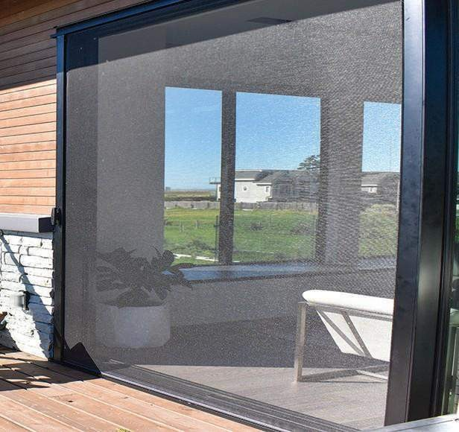
3500
Webinar
T (855) 488 7655
W miragescreensystems.com

Slide 2
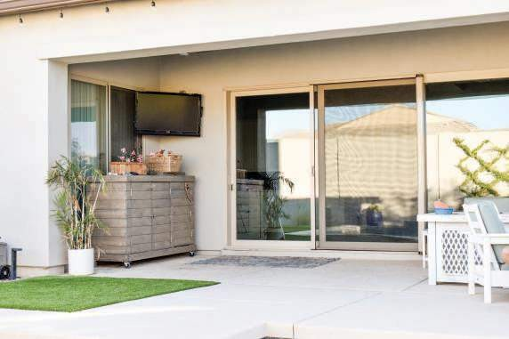
Today’s agenda
01.
02.
Applications
Components
Speciﬁcations
Color Options
Fabrics
Shipping Information

Slide 3
Applications

Slide 4
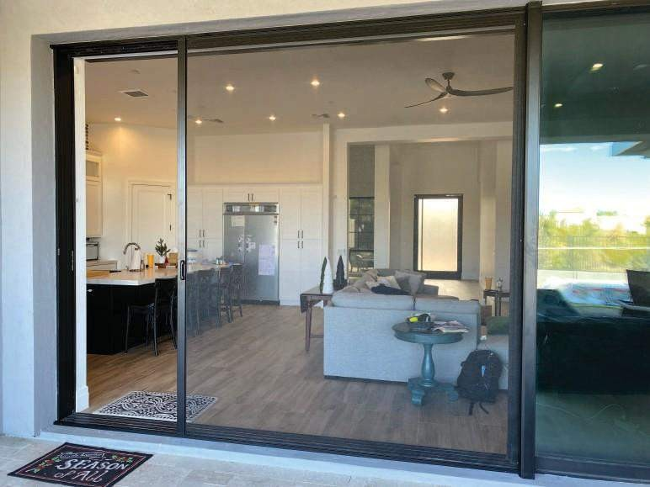
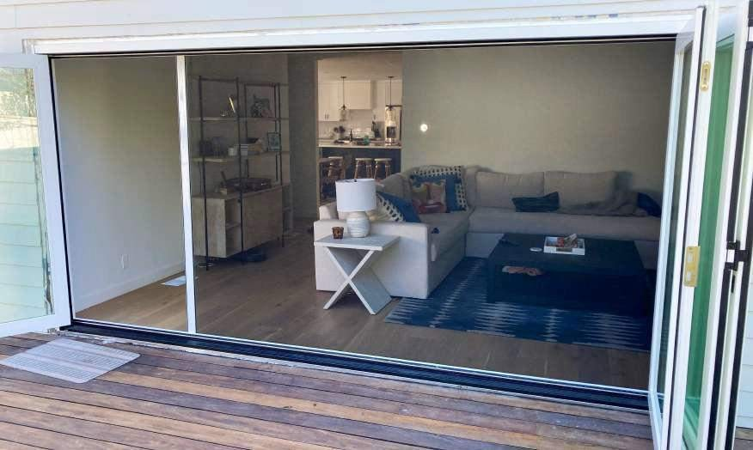
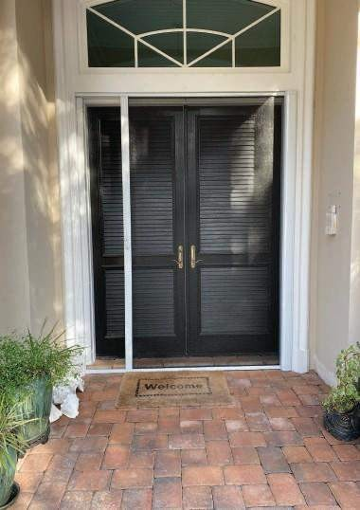
Applications
The 3500 can be applied to:
Bi-fold doors
Multi - panel sliding doors
French Doors

Slide 5
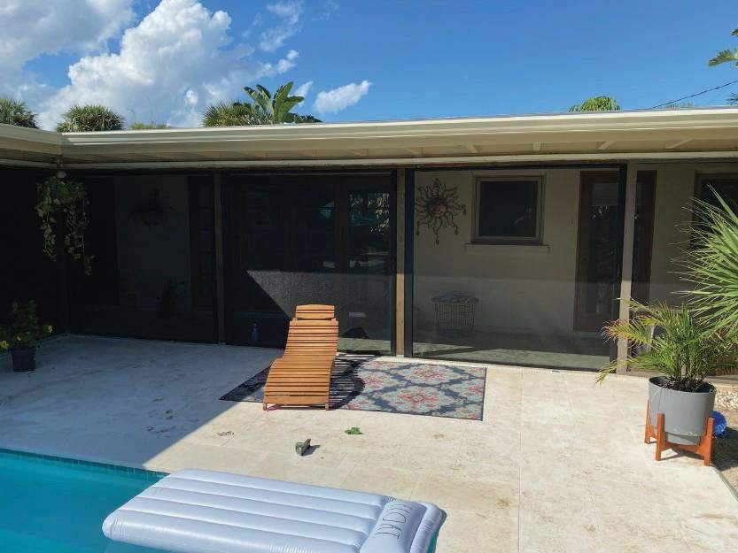
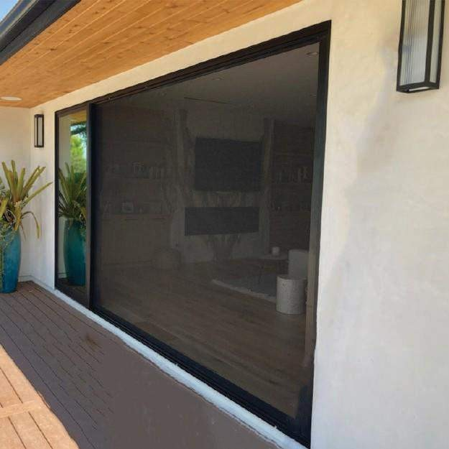
Applications
The 3500 can be applied to:
Screen rooms
Other large openings

Slide 6
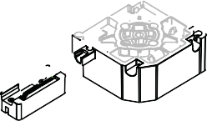
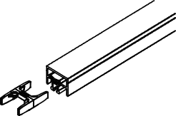
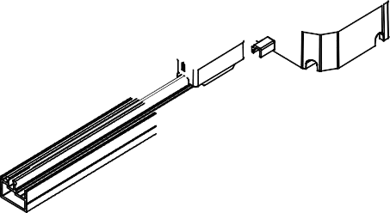
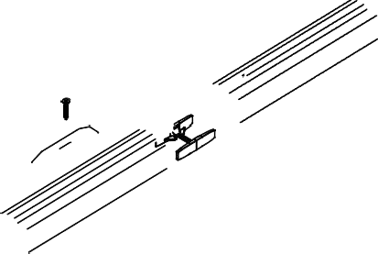
Components

Slide 7
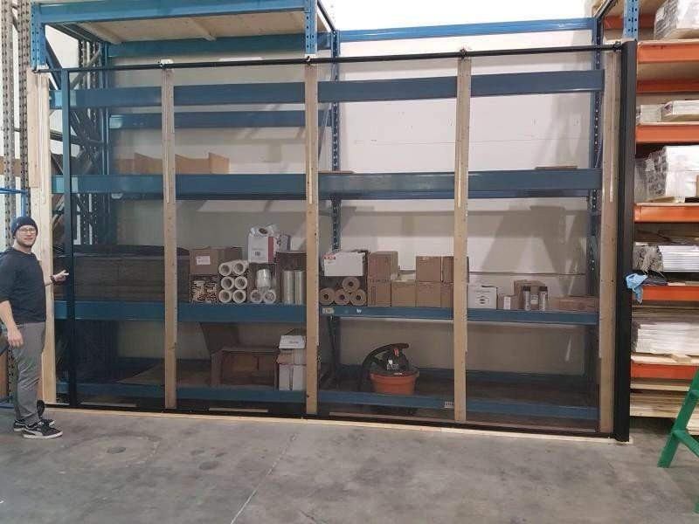
Speciﬁcations
Max 14’ Pull (28’ French/Double)
Max 10’ height
Adjustable track stops Choice of handle:
Standard
PivotPro
Recessed

Slide 8
Color Options
Standard Colors
Black
White
Sandalwood
Bronze
Non- Standard Colors
Extra charge applies.
Linen Cream, Ex Pebble Grey, Slate Grey, Tudor Brown Mirage’s 18 diamond series colors.
Custom Colors
All RAL custom colors available. Consult your sales rep for pricing.
Plastic Colors
White and black plastics are only available (Housing caps & pull bar guides). Handles are available in all standard and non-standard colors.

Slide 9
Custom Colors
Includes any of our Diamond colors
Pricing:
$300 up charge, for any of our other colors up to 3 units for this charge.

Slide 10
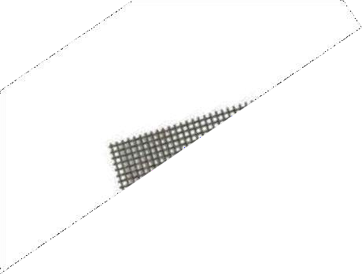
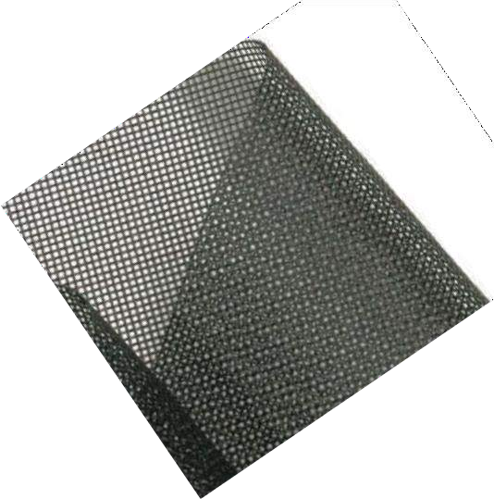
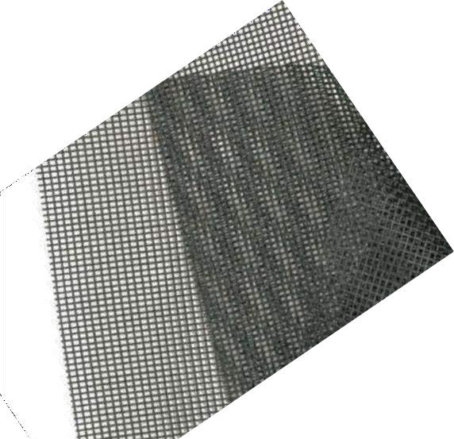
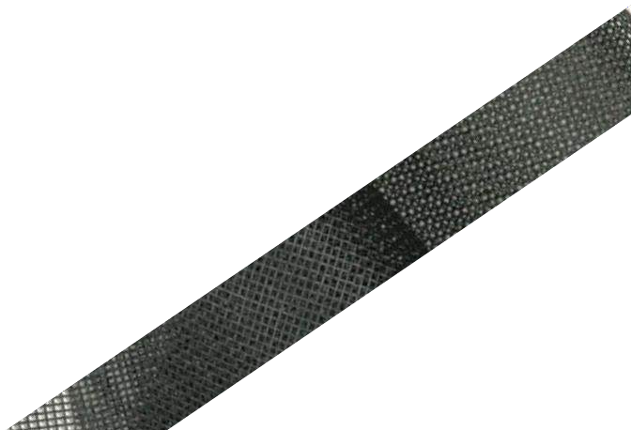
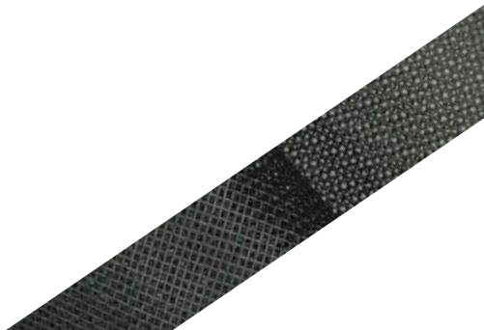
Fabrics: Insect Control
Phifer Stiff Fiberglass 18x14
Phifer NoSeeum Fiberglass
Phifer TuffScreen

Slide 11
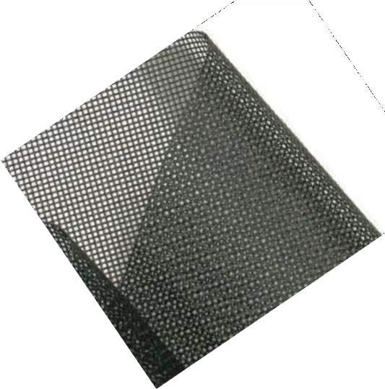
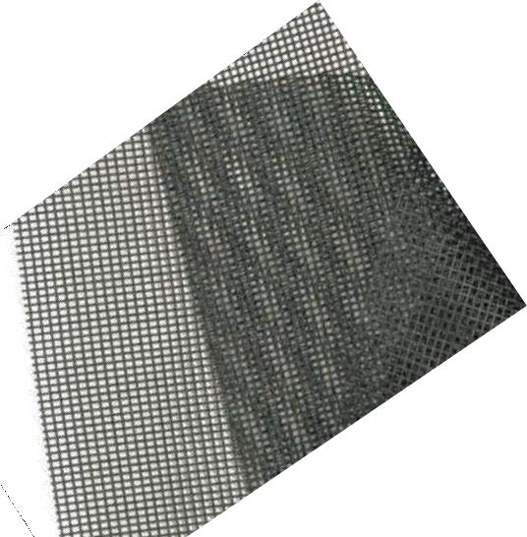
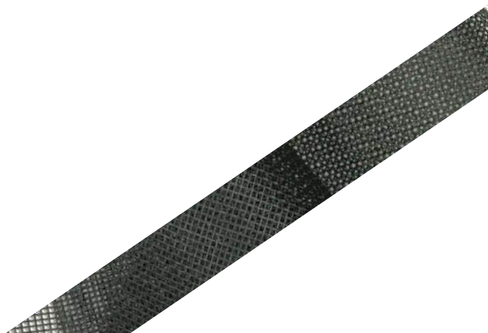
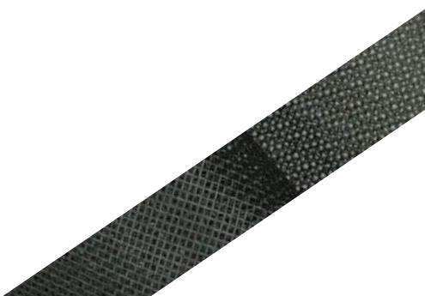
Fabrics: Sun Control
S untex 90
S untex 95
Charcoal shown
Other colors available
Charcoal shown Other colors available
Note: Sun Control fabrics may result in maximum pull
being less than 14 ft.

Slide 12
Measuring
Height:
In-jamb: Deduct 1/4” from height of opening
Note: 1X1 backing will be needed
Surface: Add 1 1/4” to height of opening
Width:
In-jamb: Supply the full width of the opening. Mirage adds 4” of width
for safety

Slide 13
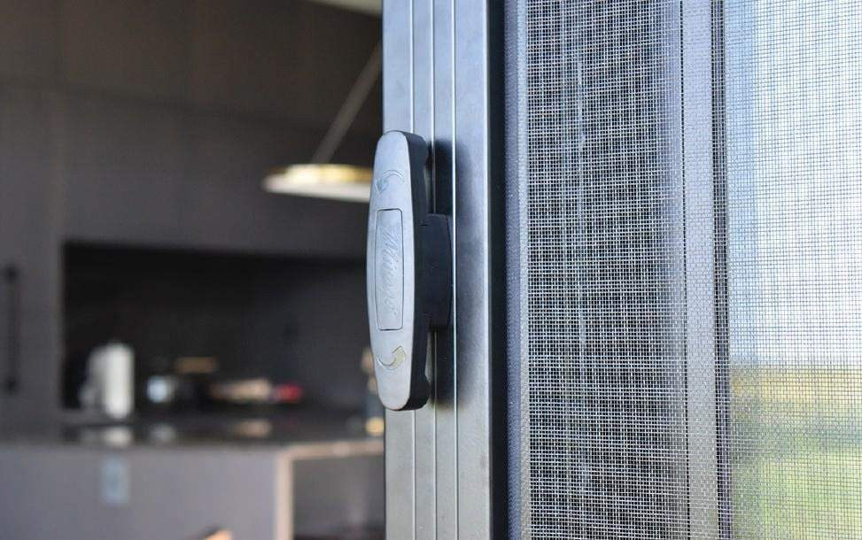
Shipping Information
Units under 8 ft
-Shipped via Fedex
-Cost is approx $100 per unit
-Ship time is 2-3 days
Units over 8ft
-Shipped via LTL
-LTL rates apply
-Up to 102 inches is $120, over is LTL (get quote from TSM)
Shipping Timeline:
To produce units 2-4 weeks Ship time 2-10 days
Non-standard /custom orders
extend the above timeline.

Slide 14
Installation Videos
Cassette and Housing Installation:
https://www.youtube.com/watch?v=6Eq1KrGZg5c
How to install the top and bottom track:
https://www.youtube.com/watch?v=OuOTEyqmHYw&t=26s
How to install the track stop:
https://www.youtube.com/watch?v=5tV4GFC2V2k
Track Splice Installation:
https://www.youtube.com/watch?v=s1-YEGlv63o

Slide 15
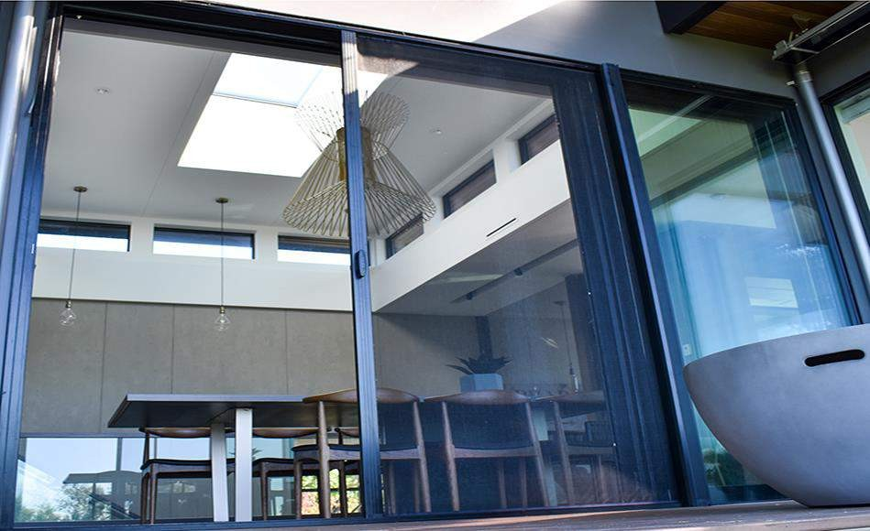
Questions??

